Slide 1

Introduction to R

Slide 2
What is R?
R is an open-source language and environment for statistical computing and graphics
It includes:
A data handling and storage facility
A suite of operators for calculations on matrices
A large collection of intermediate tools for data analysis
Graphical facilities for data analysis and display
A simple and effective programming language

Slide 3
Who uses R?
Traditionally, academics and research
Now, rapidly expanding into the enterprise market

Slide 4
Why should you learn r?
Pros:
Arguably the most common language for data scientists
Created with statistics and data in mind
Excellent for learning data science
Open source
Wide-range of high-quality packages
Cons:
Performance
Domain specificity
A few unusual features compared to other languages
Some alternatives to R:
Python: general-purpose programming with data science libraries
SAS: commercial and expensive; slower development

Slide 5
What makes r Good?
As of April 2020, R has:
15,515 packages on CRAN,
1,823 on Bioconductor, and
Many others on GitHub

Slide 6
Setting up your r environment

Slide 7
Installing r
R is open-source and cross-platform (Linux, Mac, Windows)
Link to download: https://cran.rstudio.com/
Download the latest version for your operating system and follow the instructions
A new version of R is released each year with 2-3 minor releases
It’s a good idea to update regularly

Slide 8
Running r code
RStudio is a development environment that allows the user to:
Type R commands
Write R scripts (files containing all commands to be executed)
RStudio is open-source and cross-platform (Linux, Mac, Windows)
Link to download: https://posit.co/download/rstudio-desktop/
Download the latest version for your operating system and follow the instructions
RStudio Cloud allows you to use R within RStudio without any installation
Link: https://login.rstudio.cloud/login?redirect=%2F

Slide 9

R Packages
R packages are a collection of R functions, compiled code, and sample data
They are stored under a directory called a library in the R environment
Some packages are installed by default and are automatically loaded
Additional packages are available from:
CRAN: the first and largest R repository
Bioconductor: packages for the analysis of biological data
GitHub: packages under development
In R, you can list the packages you have installed by typing

Slide 10
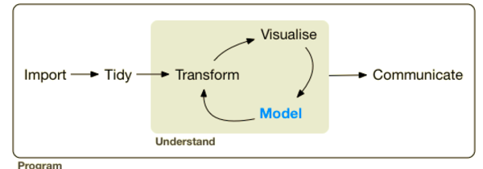
The TIDYVERSE
The tidyverse is a coherent system of R packages for data manipulation, exploration, and visualization
Intended to make data scientists more productive:
Guide through workflows
Facilitate communication
Result in reproducible products

Slide 11

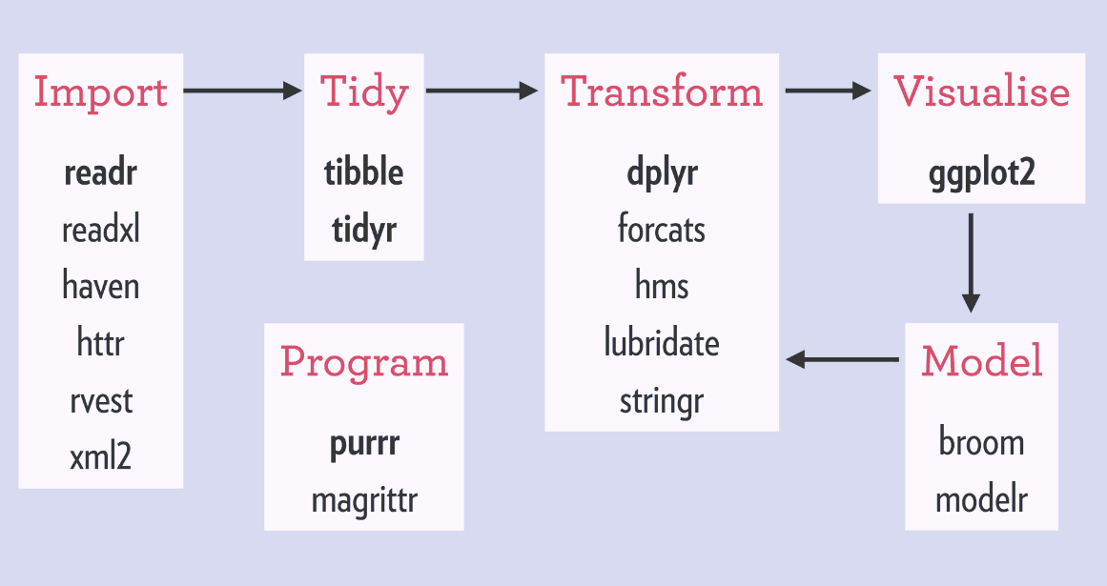
Installing the tidyverse
Install tidyverse from CRAN:
Once installed, load it with:

Slide 12
Basics of coding in r

Slide 13
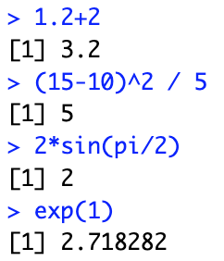
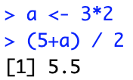


R as a calculator
You can use R as a calculator
You can create new objects with <-
In general, assignments are:
To inspect an object, type its name

Slide 14
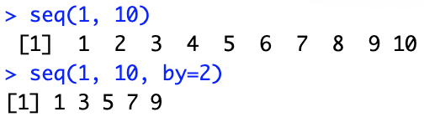

Calling functions
R has a large collection of built-in functions that are called like this:
Some arguments are set by default, others must be specified
To learn more about a function, look it up in the help pages:

Slide 15
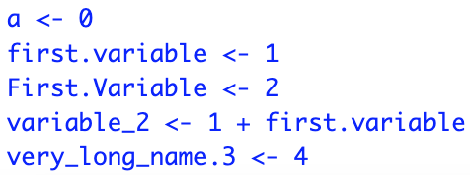
Naming objects
Object names must start with a letter and can only contain:
Letters
Numbers
The character _
The character .
Some words are reserved in R and cannot be used as object names:
Inf and –Inf, which respectively stand for positive and negative infinity
NULL denotes a null object
NA represents a missing value (“Not Available”)
NaN means “Not a Number”
R will return this value if a computation is undefined

Slide 16
Data types
There are 6 atomic classes:
Logical: TRUE/FALSE (or T/F)
Numeric: 12.4, 30, 2, 1009, 3.141593
Integer: 2, 34, -21, 0
Complex: 3 + 2i, -10 – 4i
Character: “a”, “23.5”, “good”, “Hello world!”, “TRUE”
Raw: used to hold raw bytes
Objects can have different structures based on atomic class and dimensions:
R also supports more complicated objects built upon these
Dimensions | Homogeneous | Heterogeneous
1 dimension | Vector | List (generic vector)
2 dimensions | Matrix | Data frame
n dimensions | Array

Slide 17
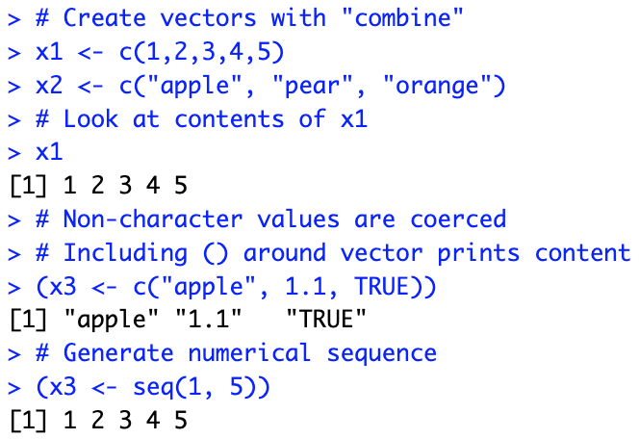
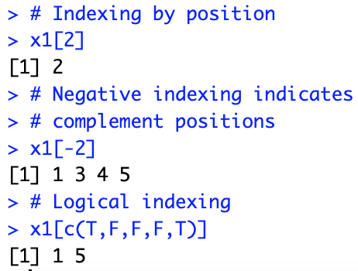
vectors
Vectors are the simplest data structure: contiguous cells containing data

Slide 18
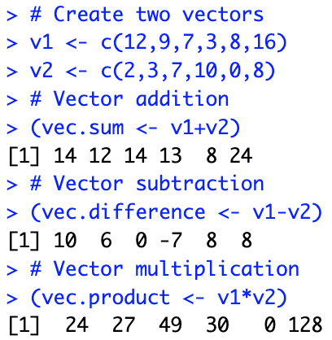
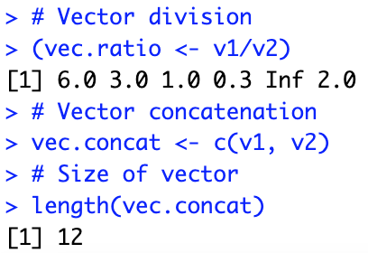
Vector arithmetic
Element-wise operations between vectors of same length

Slide 19
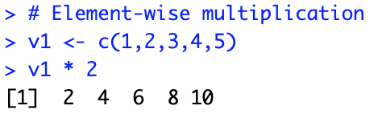
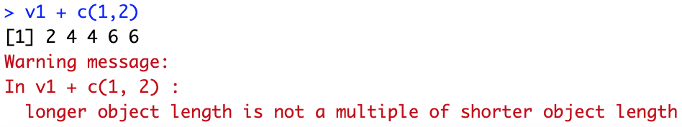
recycling
Recycling is an automatic lengthening of vectors in certain settings
R repeats the shorter vector until the length of the longer vector is reached

Slide 20
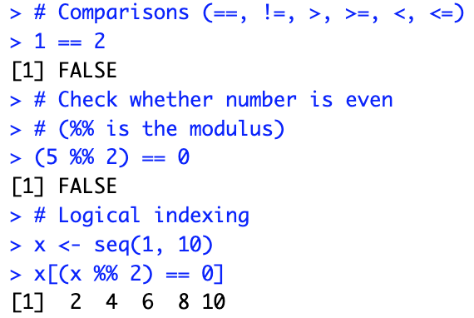
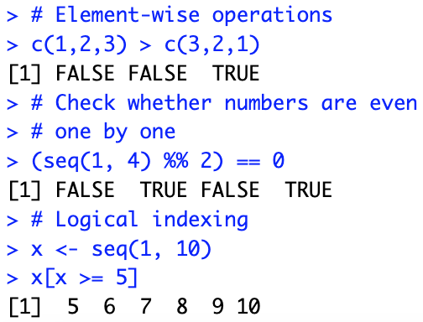
Logical operations

Slide 21
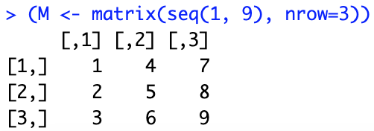
matrices
2-dimensional vectors
A matrix can be created with the function:
where:
data: input vector with elements of the matrix
nrow: number of rows to be created
ncol: number of columns to be created (default: NULL)
byrow: whether matrix is filled by columns (default: FALSE)
dimnames: list of length 2, gives row and column names (default: NULL)

Slide 22
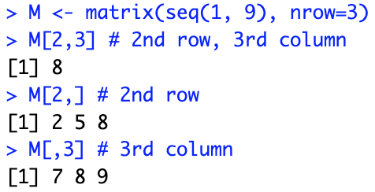
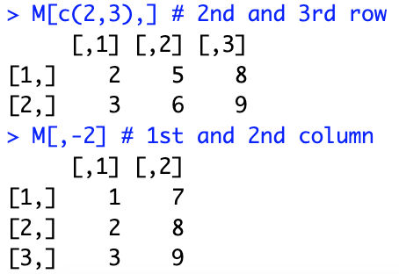

Accessing matrix elements

Slide 23
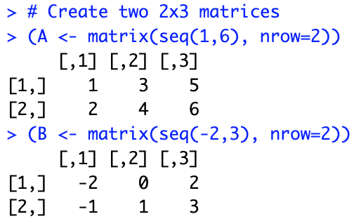
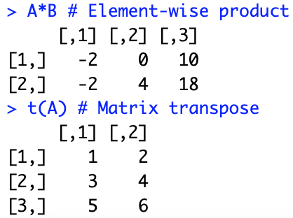
Matrix computations

Slide 24
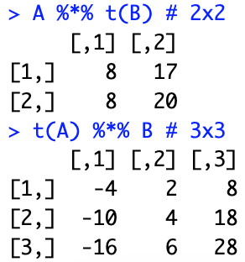
Matrix algebra
True matrix multiplication A x B

Slide 25
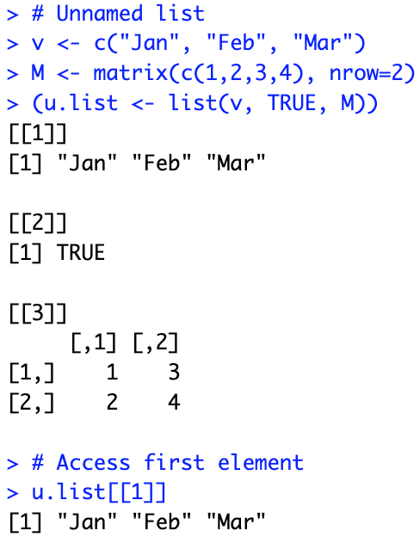
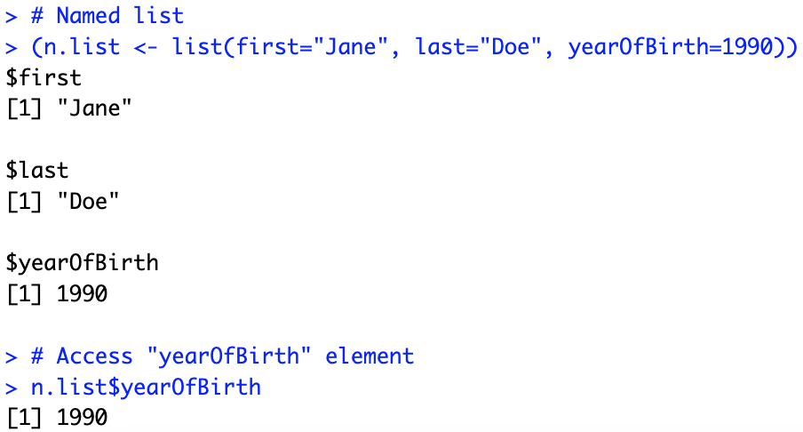
lists
Contain elements of different types, e.g., numbers, vectors, and other lists

Slide 26
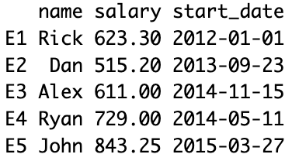

Data frames
A data frame is a table or a 2-dimensional rectangular array-like structure
Columns can store different data types, e.g., logical, numeric, character
Each column must contain the same number of data items
The column names should be non-empty
The row names should be unique
The elements can be accessed by indexing (just like matrices)
Columns can also be accessed by name

Slide 27
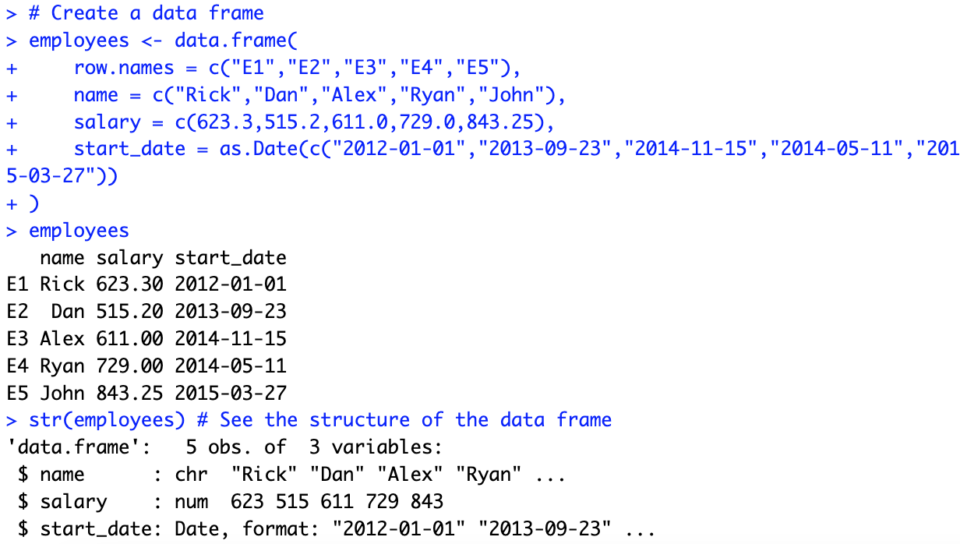
Creating data frames

Slide 28
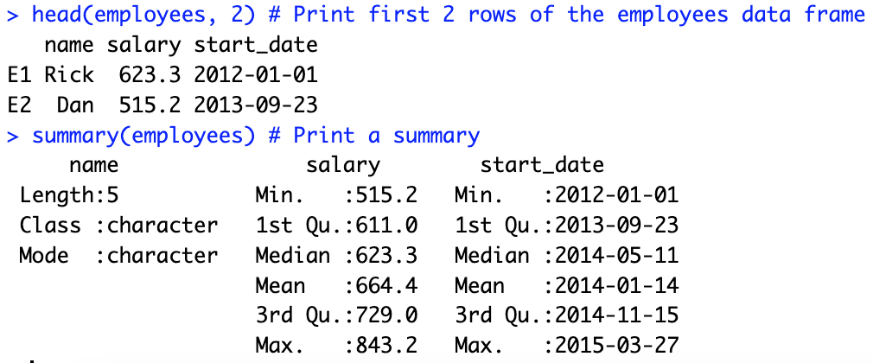
Summarizing data frames
If the data frame is large, we do not want to print all of it

Slide 29
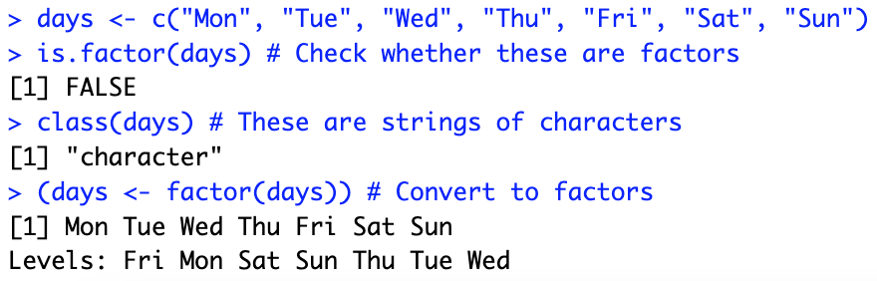
factors
Factors are used to categorize data and store it as levels
Useful for variables that can take a limited number of unique values

Slide 30
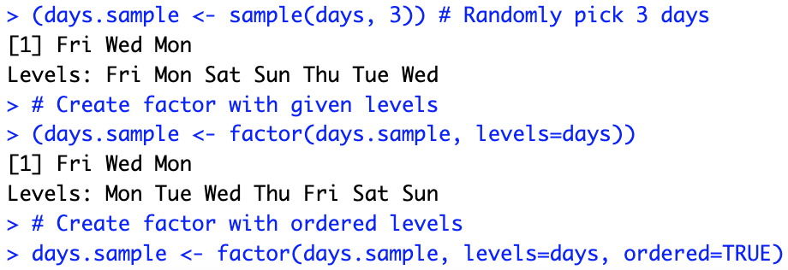
Factor ordering
If not specified, R will order character type by alphabetical order

Slide 31
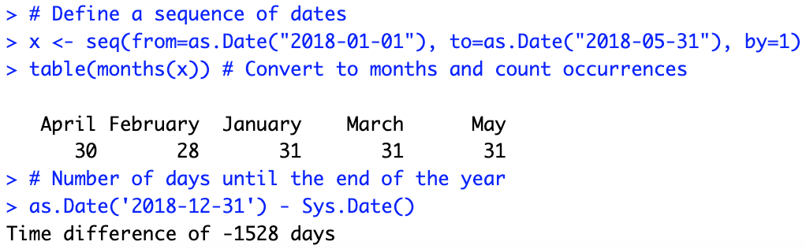
dates
R makes it easy to work with dates
Type ?strptime for a list of possible date formats

Slide 32
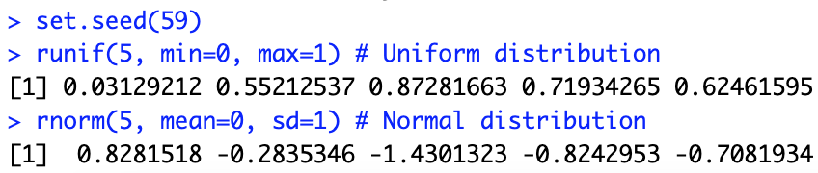
Random numbers
You can generate vectors of random numbers from different distributions
To make your results reproducible, provide a seed for the generator

Slide 33
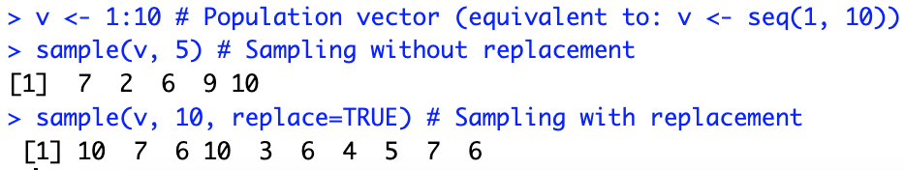
Random sampling
You can generate a random sample from the elements of a vector using the function sample

Slide 34
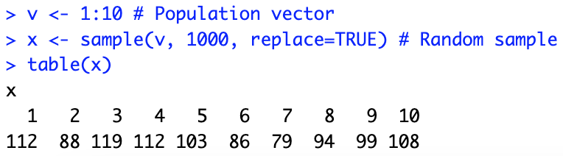
Tables
The contents of a discrete vector can be easily summarized in a table

Slide 35

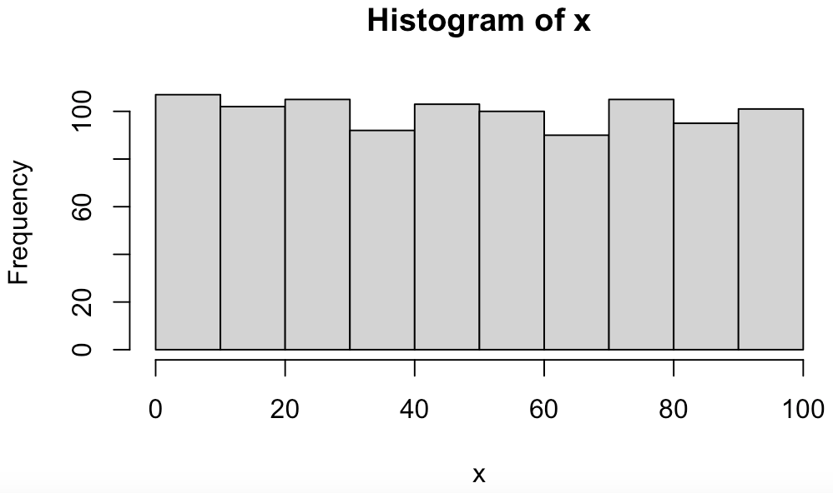
histograms
The contents of a discrete or continuous vector can be easily summarized in a histogram

Slide 36
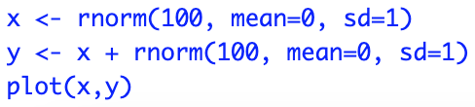
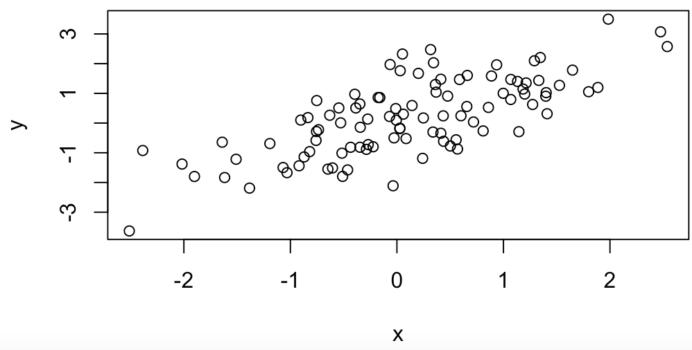
Basic plotting

Slide 37
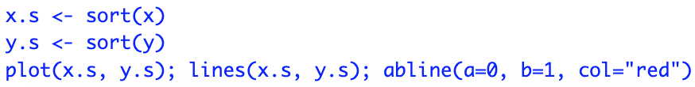
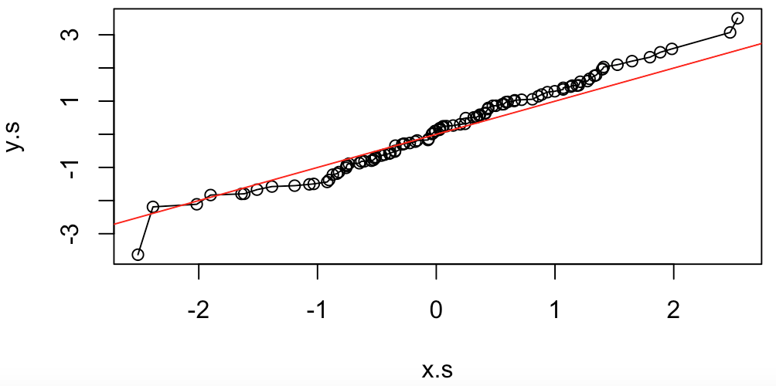
Basic plotting

Slide 38
Transforming data

Slide 39
Data transformation
Rarely do you get the data in the form you need
For example, you may need to:
Create new variables or summaries
Rename the variables
Reorder the observations
We will now learn how to do this and more

Slide 40
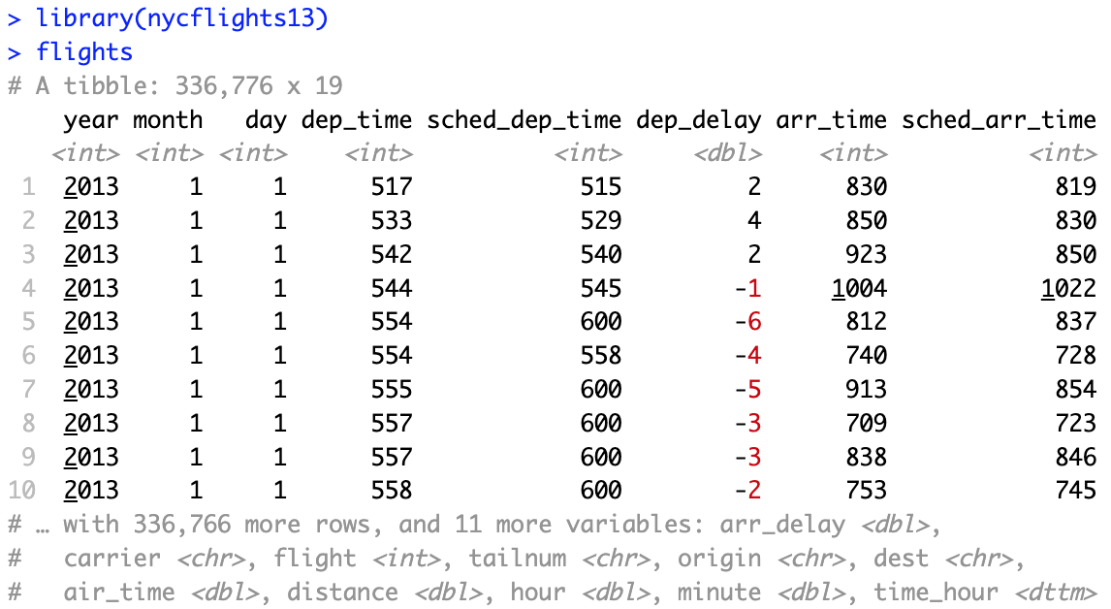
New York city flights data
Dataset on flights departing New York City in 2013

Slide 41
The dplyr package
The dplyr package is part of the core tidyverse
It solves most of your data manipulation challenges:
Pick observations by their values: filter()
Reorder the rows: arrange()
Pick variables by their names: select()
Create new variables with functions of existing variables: mutate()
Collapse many values down to a single summary: summarise()
All verbs work similarly:
The first argument is a tibble or data frame
The subsequent ones describe what to do using the variable names
The result is a new tibble

Slide 42
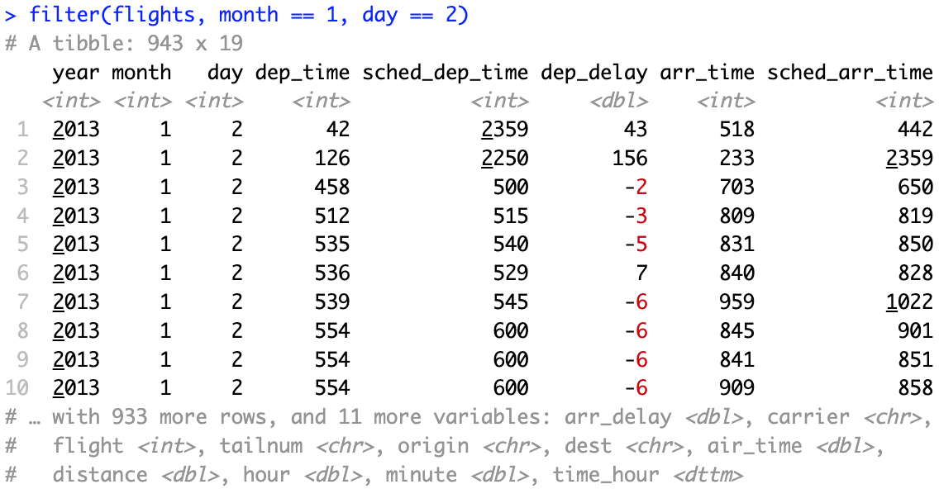
Filter rows with filter()
filter() allows you to subset observations based on their values
The package dplyr executes the filtering and returns a new data frame without modifying the original one

Slide 43
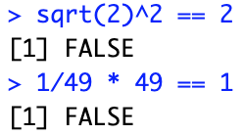
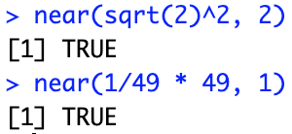
Comparison operators in r
In order to use filter(), you need to use comparison operators
R provides the standard suite: >, >=, <, <=, != (not equal), and == (equal)
The == operator can be tricky with floating point numbers
near() is the safe way of checking if two vectors of floating point numbers are (pairwise) equal

Slide 44
logical operators in r
By default, filter() combines multiple arguments with a logical AND
For example, this finds all flights that departed in November or December:

Slide 45
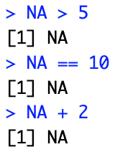
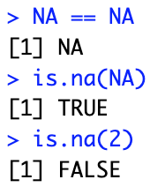
The logic of missing values in r
Missing values are contagious
filter() includes rows where a condition is TRUE (neither FALSE nor NA)

Slide 46
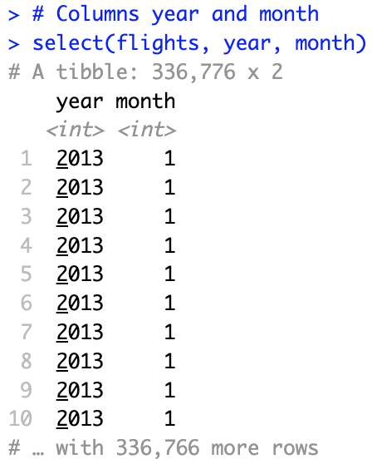
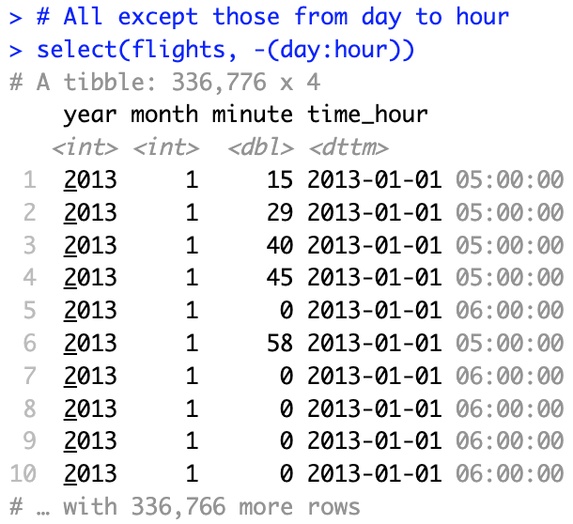
Select columns with select()
select() zooms in on a subset of variables specified by name
This is most useful for large datasets with many variables

Slide 47
Helper functions for select()
There are several helper functions you can use within select():
starts_with(“abc”): matches names that begin with “abc”
ends_with(“xyz”): matches names that end with “xyz”
contains(“ijk”): matches names that contain “ijk”
matches: selects variables that match a regular expression
num_range(“x”, 1:3): matches x1, x2, and x3
To move some columns to the beginning, use the everything() helper:
See ?select for more details

